Slide 1


AI VORTEX
1 / 7
AI systems
your team can run
A discussion brief for founders
and operations leaders
Manuel Ayala · Founder, AI Vortex
September 2026 · Scope agreed after fit review
Notes:
Offer source: https://www.aivortex.io/consulting/ ; founder source: https://www.aivortex.io/about/ . Published terms checked September 8, 2026; scope and commercial terms require agreement. Cover is an original conceptual image generated with image_gen, not client work.

Slide 2
AI VORTEX
2 / 7
When outside systems ownership helps
The work
The team
The decision
A recurring workflow is slow, inconsistent or hard to hand over.
AI is already in use. Review and context still depend on you.
You need someone to decide what should change and build the path.
A useful starting point: one workflow, an internal owner and willingness to invest.
Notes:
Offer source: https://www.aivortex.io/consulting/ ; founder source: https://www.aivortex.io/about/ . Published terms checked September 8, 2026; scope and commercial terms require agreement. These are proposed fit situations, not customer quotes or validated demand findings.

Slide 3
AI VORTEX
3 / 7
AI Systems Blueprint
An implementation decision
before committing to a build
What the team receives
Current workflow and handoff maps
Recommended architecture
Build, buy, configure or connect decisions
Review, risk and ownership controls
Pilot scope, 90-day roadmap and Loom
From $2,500
7–10 business days
Published terms. Confirmed after fit and scope.
Notes:
Offer source: https://www.aivortex.io/consulting/ ; founder source: https://www.aivortex.io/about/ . Published terms checked September 8, 2026; scope and commercial terms require agreement.

Slide 4
AI VORTEX
4 / 7
AI Systems Pilot
One workflow in
controlled use
Illustrative research workflow
Source → draft → named review → handoff
Typically 3–6 weeks
Scope and price agreed for the workflow
A missing source holds the item in review.
The reviewer resolves it before handoff.
Build, measure and hand over.
Expand only after reviewing the evidence.
After the pilot: Embedded AI Systems Partner for ongoing ownership. No public monthly package.
Notes:
Offer source: https://www.aivortex.io/consulting/ ; founder source: https://www.aivortex.io/about/ . Published terms checked September 8, 2026; scope and commercial terms require agreement. Research workflow is a fictional example, not a client implementation or result.

Slide 5
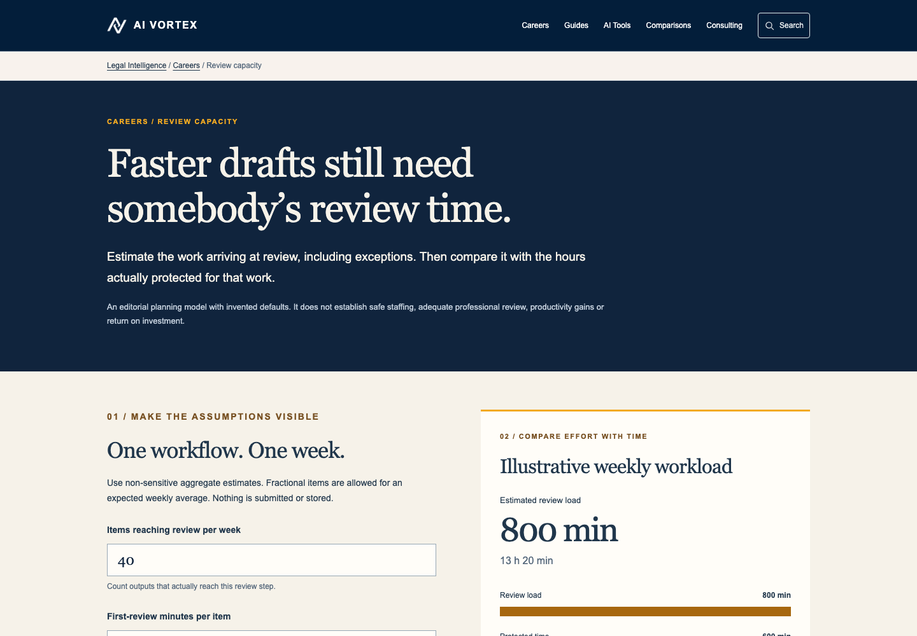
AI VORTEX
5 / 7
Public work you can inspect
Review capacity
A planning tool that separates incoming work from the time available to review it.
Legal AI Risk Intelligence
Source-linked cases and evidence in a public research interface.
Own public artifacts, not client outcomes or promised savings.
Notes:
Offer source: https://www.aivortex.io/consulting/ ; founder source: https://www.aivortex.io/about/ . Published terms checked September 8, 2026; scope and commercial terms require agreement. Public sources: https://www.aivortex.io/legal/careers-resources/review-capacity/ and https://www.aivortex.io/legal-ai-risk . Screenshot is from the real public calculator. Calculator is an editorial model, not a staffing recommendation.

Slide 6
AI VORTEX
6 / 7
Work directly with Manuel
Founder-led through handoff
I diagnose the operation, recommend the next move and stay accountable through delivery.
What your team brings
An internal owner, operating context and access that can be agreed safely. You do not need a finished AI specification.
Notes:
Offer source: https://www.aivortex.io/consulting/ ; founder source: https://www.aivortex.io/about/ . Published terms checked September 8, 2026; scope and commercial terms require agreement. Official portrait copied without retouching. No extra biography, clients or outcomes added.

Slide 7
AI VORTEX
7 / 7
Talk directly with Manuel
One workflow is enough to start.
Tell me what gets stuck, who owns it and what needs to change.
A short email is enough. Please leave out confidential files.
manuel@aivortex.io
linkedin.com/in/aivortex
aivortex.io/consulting/
Notes:
Offer source: https://www.aivortex.io/consulting/ ; founder source: https://www.aivortex.io/about/ . Published terms checked September 8, 2026; scope and commercial terms require agreement. Direct email and LinkedIn verified in existing official consulting page. No calendar, availability or response SLA is promised.

